Slide 1

3D Scene Reconstruction with Sparse LiDAR Data and Monocular Image in Single Frame
Yuanxin Zhong, Sijia Wang, Shichao Xie, Zhong Cao, Kun Jiang, and Diange Yang,
Tsinghua University

Slide 2
Outline
Introduction
Related Works
Algorithm Pipeline
Experiments
Conclusion

Slide 3
Outline
Introduction
Related Works
Algorithm Pipeline
Experiments
Conclusion

Slide 4
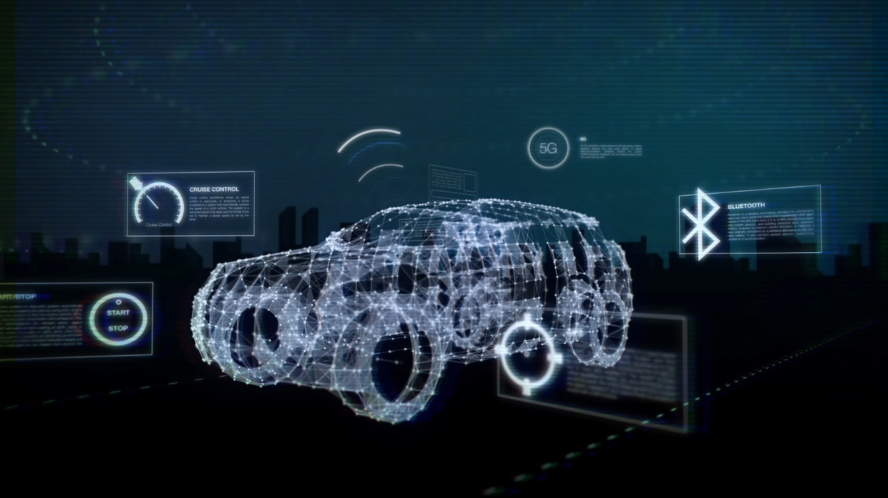
Intelligent Vehicle
LiDAR/Radar
/Vision
Sensing
Understanding
Intelligent
Image from http://www2.warwick.ac.uk/fac/sci/wmg/research/automotive/smarter/

Slide 5
Spatial Information from Computer Vision
Stereo Vision
High computational cost
Less accurate
Depth Camera
Usually used in indoor scenes
LiDAR
Precise measurement
Expensive
Fusion
for semantics
Monocular Vision
Unable to provide depth information
Rich in color

Slide 6
Outline
Introduction
Related Works
Algorithm Pipeline
Experiments
Conclusion

Slide 7
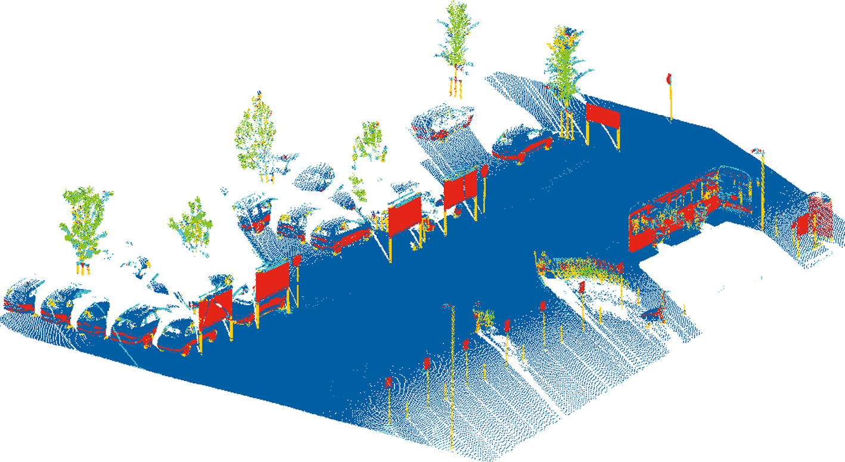
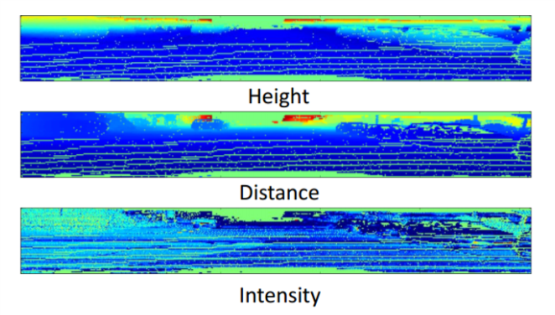
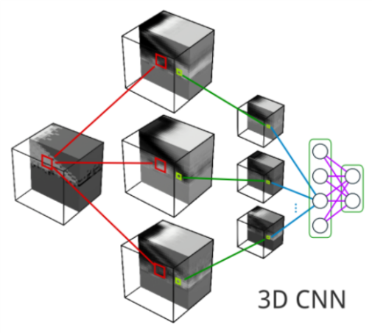
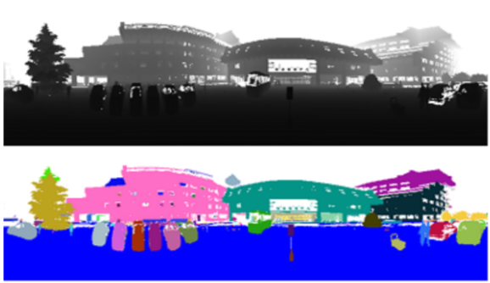
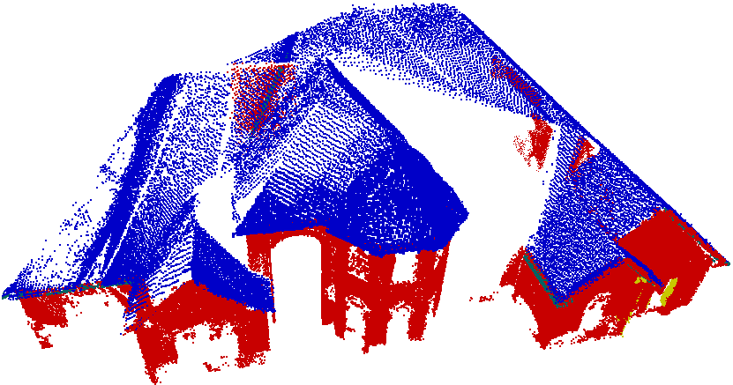
Point Cloud Segmentation
Shape based
Depth Image based
Machine Learning
Notes:
Left:
Yang, B., and Dong, Z., "A Shape-Based Segmentation Method for Mobile Laser Scanning Point Clouds," ISPRS Journal of Photogrammetry and Remote Sensing 81: 19-30, 2013
Lin, H., Gao, J., Zhou, Y., Lu, G. et al., "Semantic Decomposition and Reconstruction of Residential Scenes from LiDAR Data," ACM Transactions on Graphics (TOG) 32 (4): 1, 2013
Middle:
Chen, X., Ma, H., Wan, J., Li, B. et al., "Multi-View 3D Object Detection Network for Autonomous Driving," arXiv preprint, 2016
Zhu, X., Zhao, H., Liu, Y., Zhao, Y. et al., "Segmentation and Classification of Range Image from an Intelligent Vehicle in Urban Environment," Intelligent Robots and Systems (IROS), 2010 IEEE/RSJ International Conference on IEEE 2010: 1457-62, 201
Right:
Maturana, D. and Scherer, S., "3D Convolutional Neural Networks for Landing Zone Detection from LiDAR," Robotics and Automation (ICRA), 2015 IEEE International Conference on IEEE, 2015

Slide 8
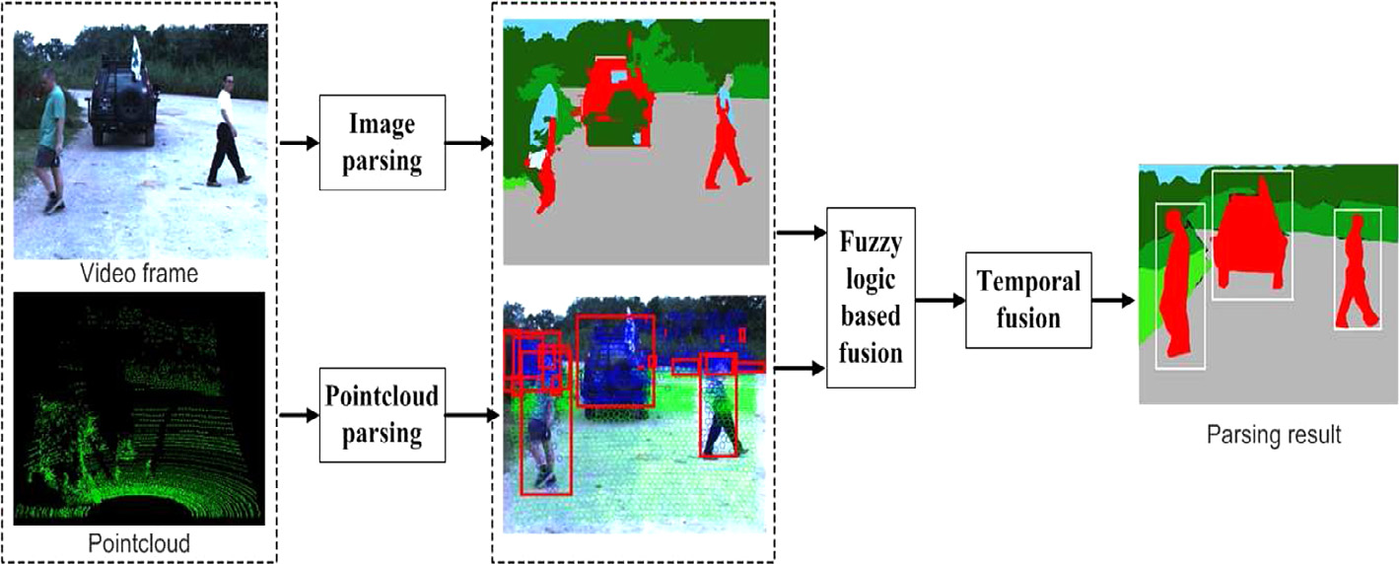
Point Cloud Segmentation
Image + Point Cloud
Image Parsing
Pyramid CNN
Fusion
Hierarchical Fusion
Notes:
Zhao, G., Xiao, X., Yuan, J. and Ng, G. W., "Fusion of 3DLIDAR and Camera Data for Scene Parsing," Journal of Visual Communication and Image Representation, 2014, 25(1)
This work inspired us. There are two innovation make our approach stand out, one is using CNN to perform much more precise segmentation, another is having developed hierarchical fusion method to fuse the two segmentation results with the integrity of objects conservated.

Slide 9
Outline
Introduction
Related Works
Algorithm Pipeline Image Segmentation Point Cloud Segmentation Hierarchical Fusion
Experiments
Conclusion
Notes:
There are several techniques used in our system. Here I’m going to introduce them.

Slide 10
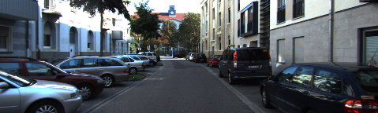
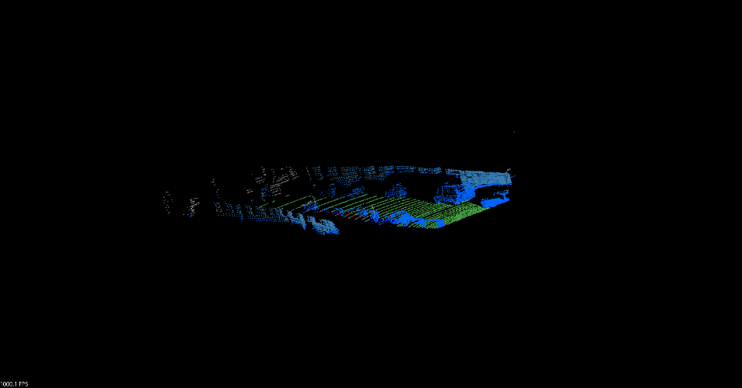
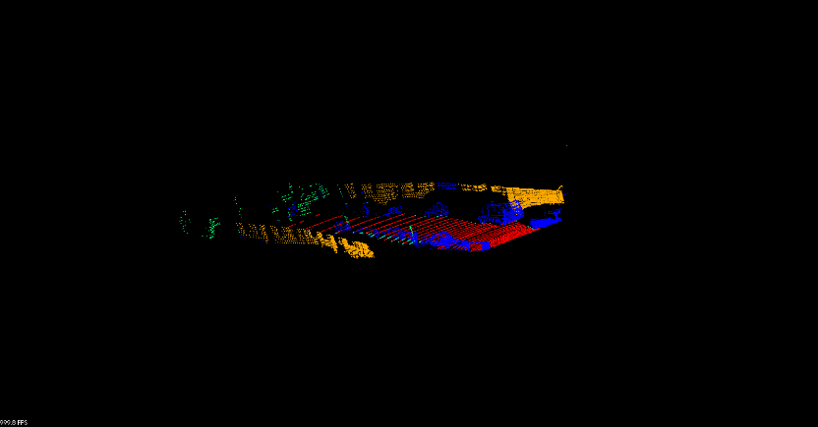
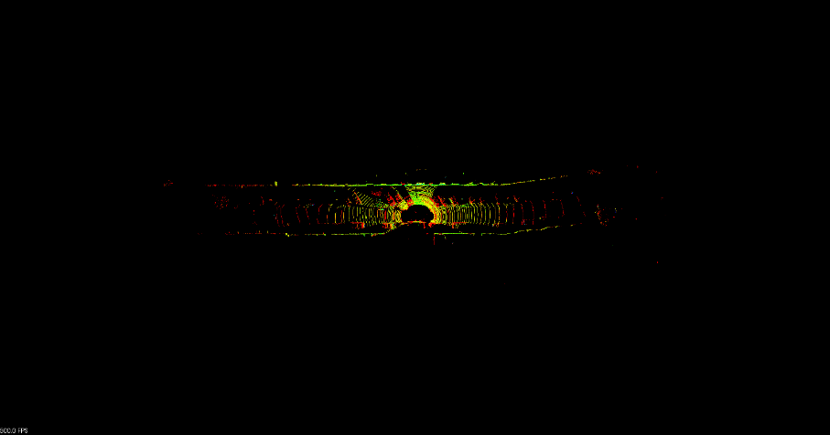
Overview
Data Source:
KITTI Dataset
Monocular Color Image
Colors, Texture, Adjacency
Image Segmentation
LiDAR Point Cloud
Precise Locations Spatial Relation
（Alignment）
Fusion
Point Cloud Segmentation

Slide 11
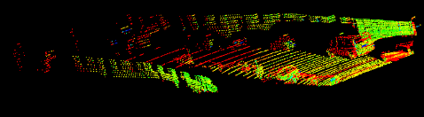
Point Cloud Segmentation
Object: Point Cloud → Cropped Point Cloud
→ Semantic Point Cloud Segments
Cropping:
Fit the FoV of the image
Notes:
FoV: Field of View

Slide 12
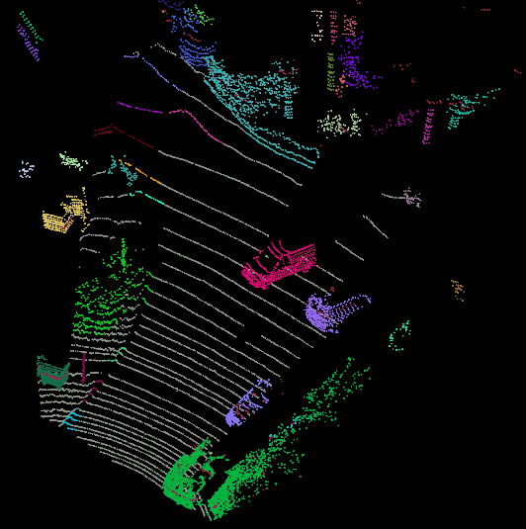

Point Cloud Segmentation
Object: Point Cloud → Cropped Point Cloud
→ Semantic Point Cloud Segments
Down Sampling
Voxel Grid
Support Plane Extraction
RANSAC
Object Clustering
Euclidean Clustering
Notes:
FoV: Field of View

Slide 13
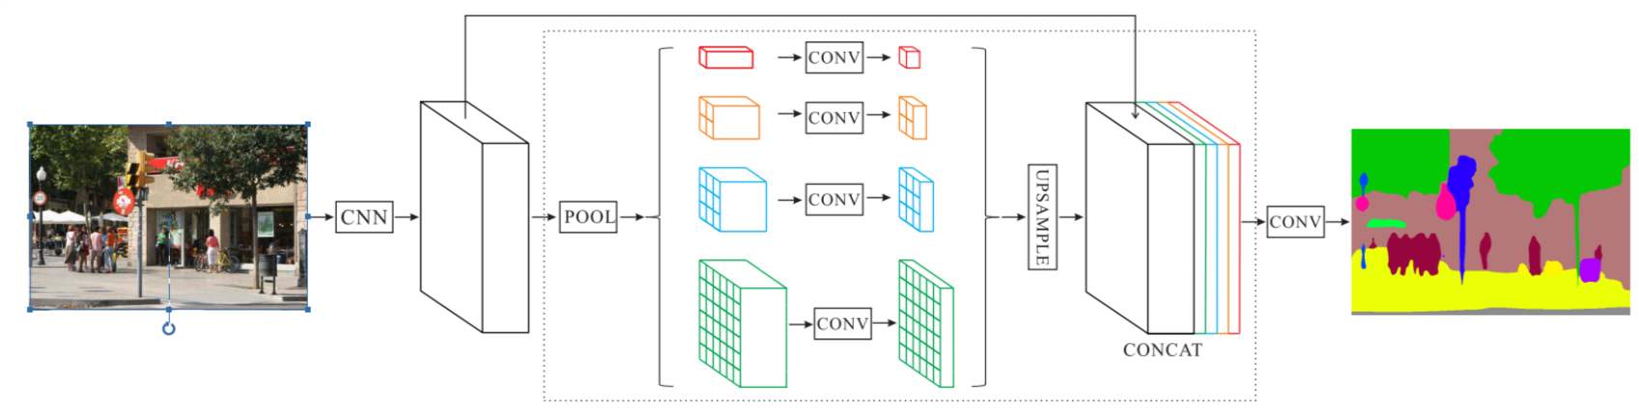
Image Semantic Segmentation
Object: Image → Semantic Image Segments
→ Semantic Point Cloud Segments
PSPNet
Zhao, H., Shi, J., Qi, X., Wang, X. et al., "Pyramid Scene Parsing Network," arXiv preprint, 2016

Slide 14
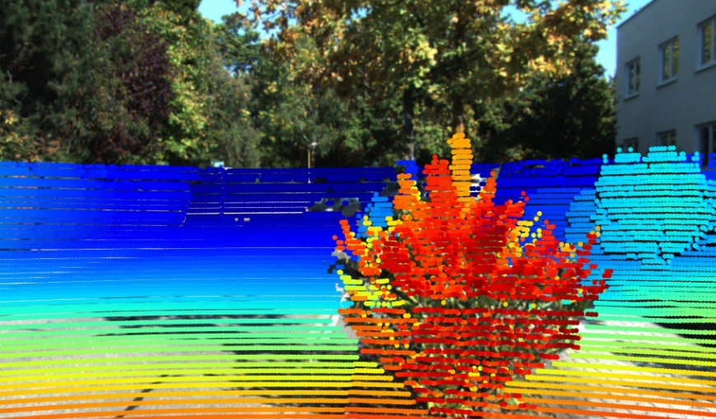
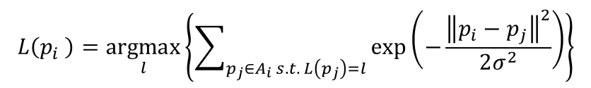
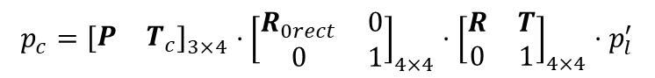
Image Semantic Segmentation
Object: Image → Semantic Image Segments
→ Semantic Point Cloud Segments
Projection
$$p_{c}={\left[\begin{matrix}P & T_{c}\end{matrix}\right]}_{3×4}⋅{\left[\begin{matrix}R_{0rect} & 0 \\ 0 & 1\end{matrix}\right]}_{4×4}⋅{\left[\begin{matrix}R & T \\ 0 & 1\end{matrix}\right]}_{4×4}⋅p_{l}^{′}$$
Label Transfer
$$L\left(p_{i} \right)=\underset{l}{argmax}\left\{\sum_{p_{j}∈A_{i} s.t. L\left(p_{j}\right)=l}{\exp\left(−\frac{{\left\|p_{i}−p_{j}\right\|}^{2}}{2σ^{2}}\right)}\right\}$$
Notes:
Through this process, every point in the range of image gets its label

Slide 15
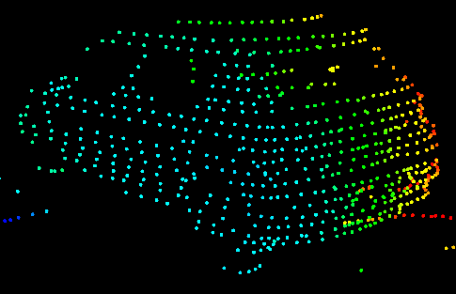
Hierarchical Segments Fusion
Image Segments → Labelled Points
Point Cloud Segments → Object Clusters
Fusion: Aggregate labels in object
Traffic facility
Traffic pole
Car
…
Label Hierarchy
Traffic lights
Traffic sign
Traffic pole
Truck
Bus

Slide 16
Outline
Introduction
Related Works
Algorithm Pipeline
Experiments
Conclusion

Slide 17
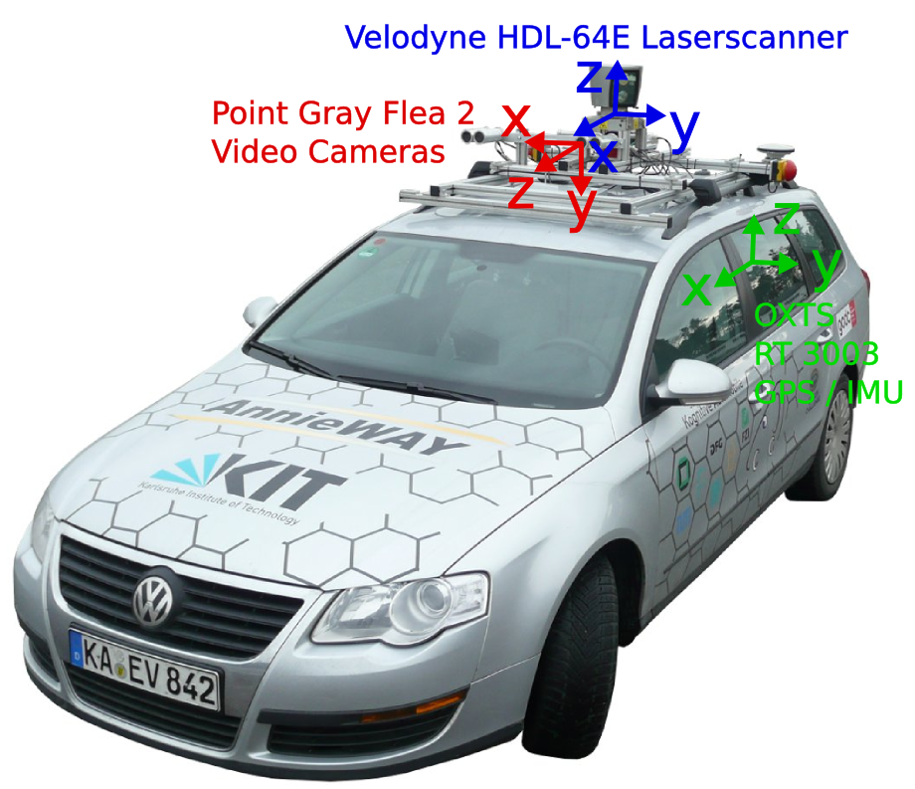
Experiment
Raw Data
Image Files and Point Cloud Files
252 frames
333K points
Hand-labelled groundtruth from Zhang et al.
KITTI Recording Platform Setup
Geiger, A., Lenz, P. and Urtasun, R., "Are we ready for autonomous driving? The KITTI vision benchmark suite," IEEE Conference on Computer Vision and Pattern Recognition, 2012

Slide 18
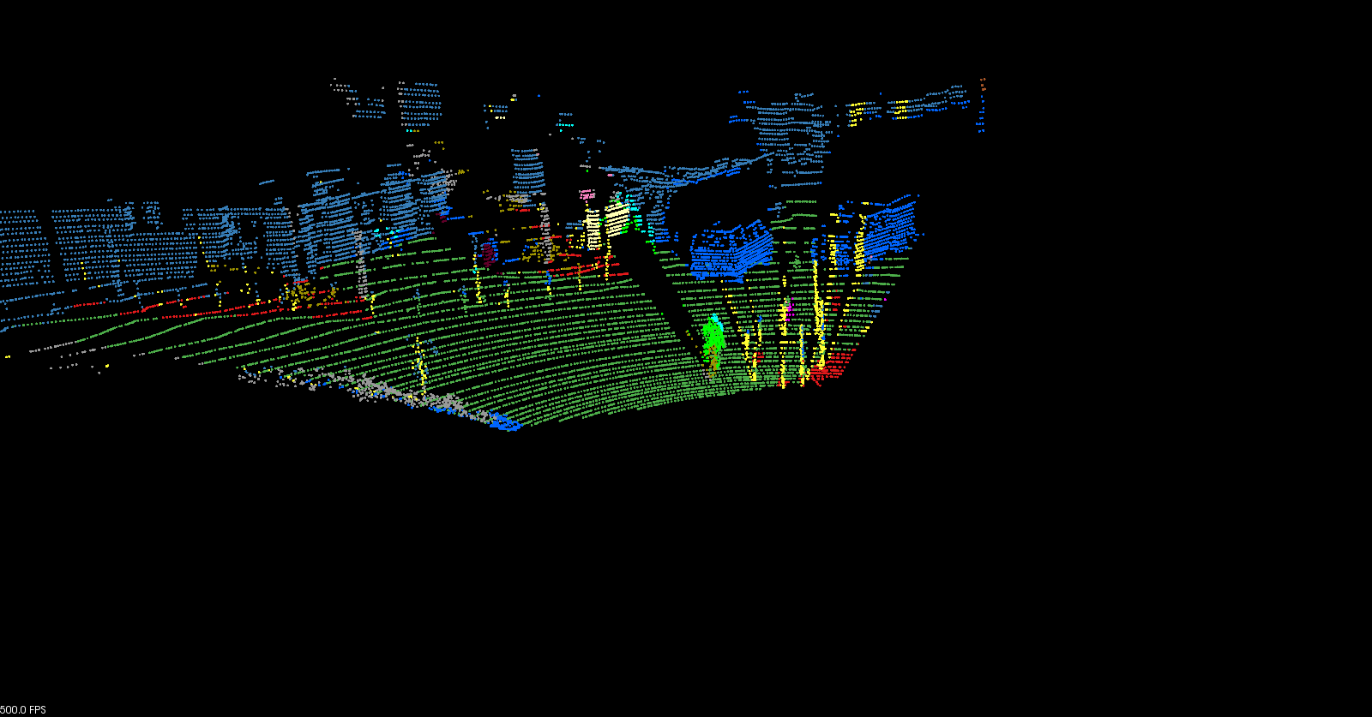
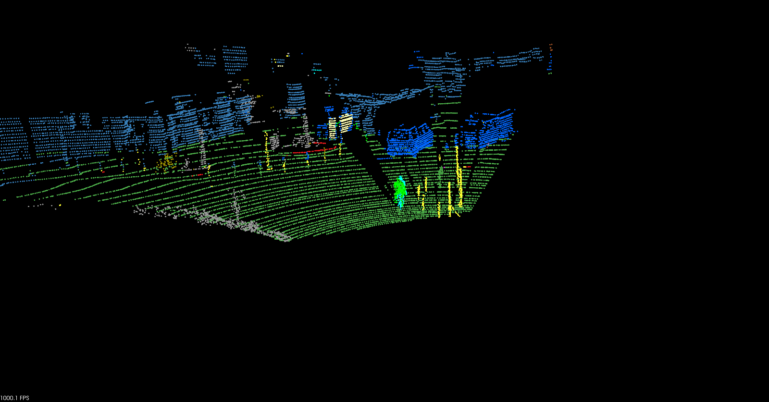
Experiment Result
Image Labelled Sample
Hierarchical Fused Sample
With hierarchical fusion:
Mean IoU: 67.73% Point-wise Accuracy: 80.07%
Notes:
Misalignments are corrected. Object integrity is conserved.
IoU: Intersection over Union

Slide 19
Outline
Introduction
Related Works
Algorithm Pipeline
Experiments
Conclusion

Slide 20
Conclusion
Point Cloud Semantic Segmentation System
Use CNN to generate accurate label
Use hierarchical algorithm to fuse image and point cloud segments
Further Improvements
Better segments generation
More efficient algorithm making the system real-time capable
Notes:
So now finally, we can make the conclusion. In our study, we apply complex network theory to the analysis and improvement of the vehicle information sharing networks. By targeting only a few specific vehicle clusters to add long-range connections, the coverage can be considerably extended. And by employing the methods developed for square lattices, the efficiency can be improved. Besides, we also find that the proposed method can be applied to other areas such as the spreading of epidemic diseases or mobile phone virus. From these three points we can see that we achieve our goals successfully.

Slide 21
References
Geiger, Andreas, Philip Lenz, and Raquel Urtasun. 2012. “Are We Ready for Autonomous Driving? The KITTI Vision Benchmark Suite.” In Conference on Computer Vision and Pattern Recognition (CVPR). doi:10.1109/CVPR.2012.6248074.
Schnabel, R, R Wessel, R Wahl, and R Klein. 2007. “Shape Recognition in 3D Point Clouds Shape Recognition in 3D Point-Clouds.” Symposium A Quarterly Journal In Modern Foreign Literatures 2 (1): 40–51. doi:10.1306/D4268F04-2B26-11D7-8648000102C1865D.
Yang, Bisheng, and Zhen Dong. 2013. “A Shape-Based Segmentation Method for Mobile Laser Scanning Point Clouds.” ISPRS Journal of Photogrammetry and Remote Sensing 81. International Society for Photogrammetry and Remote Sensing, Inc. (ISPRS): 19–30. doi:10.1016/j.isprsjprs.2013.04.002.
Douillard, Bertrand, J. Underwood, N. Kuntz, V. Vlaskine, A. Quadros, P. Morton, and A. Frenkel. 2011. “On the Segmentation of 3D LIDAR Point Clouds.” 2011 IEEE International Conference on Robotics and Automation, 2798–2805. doi:10.1109/ICRA.2011.5979818.
Barnea, Shahar, and Sagi Filin. 2013. “Segmentation of Terrestrial Laser Scanning Data Using Geometry and Image Information.” ISPRS Journal of Photogrammetry and Remote Sensing 76: 33–48. doi:10.1016/j.isprsjprs.2012.05.001.
Lin, Hui, Jizhou Gao, Yu Zhou, Guiliang Lu, Mao Ye, Chenxi Zhang, Ligang Liu, and Ruigang Yang. 2013. “Semantic Decomposition and Reconstruction of Residential Scenes from LiDAR Data.” ACM Transactions on Graphics 32 (4): 1. doi:10.1145/2461912.2461969.
Zhu, Xiaolong, Huijing Zhao, Yiming Liu, Yipu Zhao, and Hongbin Zha. 2010. “Segmentation and Classification of Range Image from an Intelligent Vehicle in Urban Environment.” Iros, 1457–62. doi:10.1109/IROS.2010.5652703.
Chen, Xiaozhi, Huimin Ma, Ji Wan, Bo Li, and Tian Xia. 2016. “Multi-View 3D Object Detection Network for Autonomous Driving.” http://arxiv.org/abs/1611.07759.
Valentin, J, S Sengupta, J Warrell, A Shahrokni, and P Torr. 2013. “Mesh Based Semantic Modelling for Indoor and Outdoor Scenes.” IEEE Computer Vision and Pattern Recognition (CVPR). doi:10.1109/CVPR.2013.269
Habermann, D., a. Hata, D. Wolf, and F.S. Osorio. 2013. “Artificial Neural Nets Object Recognition for 3D Point Clouds.” 2013 Brazilian Conference on Intelligent Systems, 101–6. doi:10.1109/BRACIS.2013.25.

Slide 22
References
Maturana, Daniel, and Sebastian Scherer. 2015. “3D Convolutional Neural Networks for Landing Zone Detection from LiDAR.” International Conference on Robotics and Automation, no. Figure 1. doi:10.1109/ICRA.2015.7139679.
Zhao, Gangqiang, Xuhong Xiao, Junsong Yuan, and Gee Wah Ng. 2014. “Fusion of 3D-LIDAR and Camera Data for Scene Parsing.” Journal of Visual Communication and Image Representation 25 (1). Elsevier Inc.: 165–83. doi:10.1016/j.jvcir.2013.06.008.
Kundu, Abhijit, Yin Li, Frank Daellert, Fuxin Li, and James M Rehg. 2014. “Supplementary Material for Joint Semantic Segmentation and 3D Reconstruction from Monocular Video.” Computer Vision--ECCV 2014, 2–3. doi:10.1007/978-3-319-10599-4_45.
Zhao, Hengshuang, Jianping Shi, Xiaojuan Qi, Xiaogang Wang, and Jiaya Jia. 2016. “Pyramid Scene Parsing Network.” http://arxiv.org/abs/1612.01105.
Cordts, Marius, Mohamed Omran, Sebastian Ramos, Timo Rehfeld, Markus Enzweiler, Rodrigo Benenson, Uwe Franke, Stefan Roth, and Bernt Schiele. 2016. “The Cityscapes Dataset for Semantic Urban Scene Understanding.” In Proc. of the IEEE Conference on Computer Vision and Pattern Recognition (CVPR).
Rusu, Radu Bogdan, and Steve B Cousins. 2011. “3D Is Here: Point Cloud Library (PCL).” In International Conference on Robotics and Automation, 1–4. doi:10.1109/ICRA.2011.5980567.
Papon, Jeremie, Alexey Abramov, Markus Schoeler, and Florentin Worgotter. 2013. “Voxel Cloud Connectivity Segmentation - Supervoxels for Point Clouds.” Computer Vision and Pattern Recognition, 2027–34. doi:10.1109/CVPR.2013.264.
Golparvar-Fard, Mani, Vahid Balali, and de la Jesus M. Garza. 2012. “Segmentation and Recognition of Highway Assets Using Image-Based 3D Point Clouds and Semantic Texton Forests.” Journal of Computing in Civil Engineering 10 (1061): 1943–5487. doi:10.1061/(ASCE)CP.1943-5487.0000283.
Zhang, Richard, Stefan A. Candra, Kai Vetter, and Avideh Zakhor. 2015. “Sensor Fusion for Semantic Segmentation of Urban Scenes.” 2015 IEEE International Conference on Robotics and Automation (ICRA), 1850–57. doi:10.1109/ICRA.2015.7139439.

Slide 23
Thank you
Sijia Wang,
A639, Lee Shau Kee Sci&Tech Building,
Tsinghua University

